Slide 1
College Timetable Management System
St. Thomas’ College of Engineering & Technology
Group Number 14
Monalisa Mondal (Roll No.51)
Subarna Paul (Roll No. 58)
Abhishek Shaw (Roll No. 70)

Slide 2
A timetable is a kind of schedule that sets out times at which specific events are intended to occur.
In a college timetable the elements are:
Day
Period
Teacher name
Department
Year
Semester

Slide 3
Time Table Management system is an automated system which generates time table according to the data given by the user.
The system takes details of faculty, subjects, periods, semesters and
Generate Timetable.
Timetable will be generated department-semester wise , Lab wise and
Faculty wise.

Slide 4
Objective
Reduces man power
Reduces time wasted
Optimizes resource allocation
Eliminate Paper-based Processes

Slide 5
Constraints
Constraints are the fundamental elements of a timetable that the software use to create the timetable and must be abided by.
Constraints are of two type:
Hard Constraints
Soft Constraints

Slide 6
Hard Constraints:
A classroom is not assigned to more than one lecture at same time.
An instructor cannot teach more than one subject at the same time.
Two Courses for the same year-session students of a department cannot take place at same time except for elective subject in theoretical class and two different labs for which department are divided into sub groups may be scheduled together.
The lectures are not allotted to time slots which come under the lecturer’s prohibited time zones.
Practical subjects can start from 1st, 2nd and 5th period only and are held for 3 hours continuously so they end on 3rd, 4th and 7th period respectively.

Slide 7
Soft Constraints
Practical classes of 4th year should get first preference and must be scheduled in the first half i.e. first four periods.
All non-laboratory classes should be scheduled in the second half i.e. last 3 periods for any year.
A subject should not have more than one class on a particular day.
Two consecutive classes should not be taken by same teacher.
One subject should not assign more than once in one day.
There should not be off period in between.
One teacher should have a non-teaching day in a week.
Theoretical Classes should not be in second half.

Slide 8
Functionality

Slide 9
Users of the systems:
Admin
Head of the Department
Faculty

Slide 10
Admin features:
Generate timetable
View timetable
Add user
View user details
Update user details
Delete user
Add lab

Slide 11
Head Of the Department features:
View timetable
Assign subject to faculty
Assign lab to faculty
Update subject Details
Insert Department
Insert subject
Delete Subject

Slide 12
Faculty features:
View Timetable
Give subject preference

Slide 13
Design methodologies

Slide 14
Data Flow Diagram(Level 0):
A D M I N
View timetable
Generate timetable
View user details
Add user
H
O
D
F
A
C
U
L
T
Y
Assign subject
TIMETABLE
MANAGEMENT
SYSTEM
View timetable
Give Subject Preference
View the response
Post notice

Slide 15
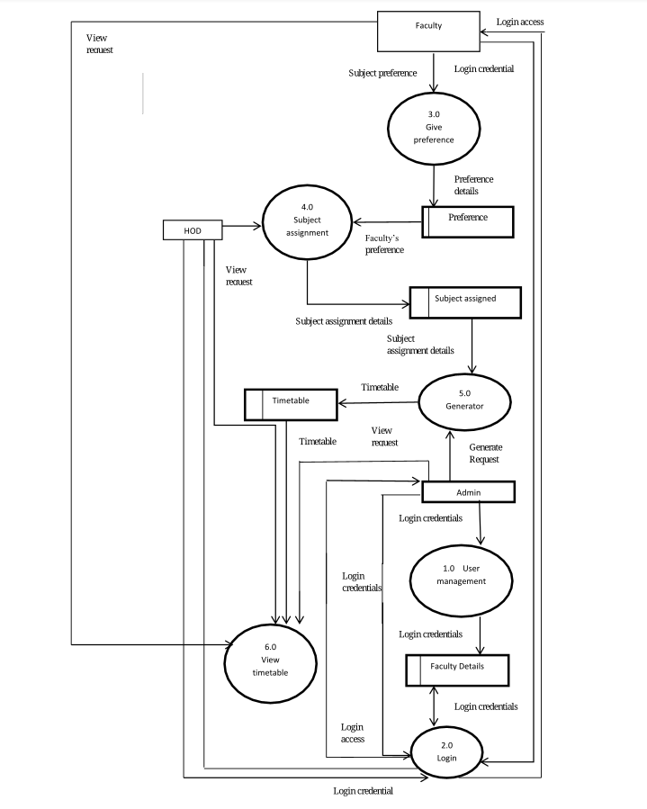
Data Flow Diagram(Level1) :

Slide 16
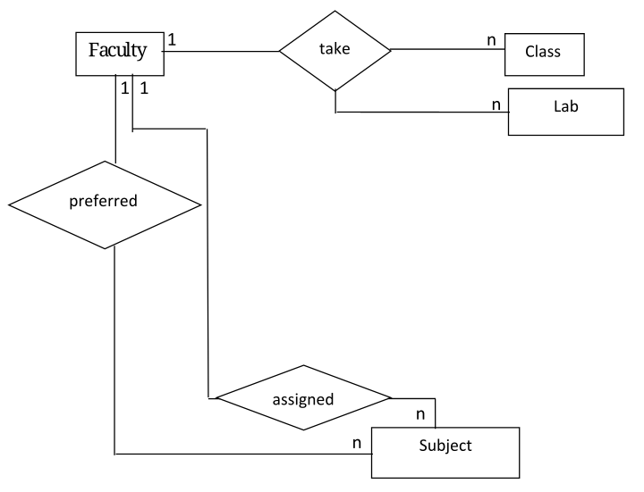
Entity-Relationship Diagram:

Slide 17
Modules

Slide 18
Modules:
User management module
Login management module
Subject management module
Subject preference module
Subject assign module
Timetable generation module

Slide 19
User management module:
Record user details
Update user details
Delete user details
Show all user details
Retrieve member’s information

Slide 20
Login management module:
Login function provides the login to member and managed authentication .The system shall track login details

Slide 21
Subject management module:
The system displays records of all subjects.
The system records the subjects' details.
The system records the labs' details.
The system deletes subject details.
The system updates subject details.

Slide 22
Subject preference module:
The system provides faculties to enter their subject preference which they want to teach.

Slide 23
Subject assign module
The system provides HOD to assign teacher to subject.
The system provides HOD to assign teacher to lab.

Slide 24
Generation module:
The system will show timetable year and department wise.
The system shall track all details about lab.
Faculty can see his/her timetable.

Slide 25
Database Design

Slide 26
Faculty Table:
Field Name | Type | Field Properties | Description
FID | Int | Primary key | Faculty ID
F_FIRSTNAME | Varchar | Not null | password
F_LASTNAME | Varchar | Not null | Faculty Name
F_PASSWORD | Varchar | Not null | password
ADMINRIGHTS | Varchar | ‘Y’ or ‘N’ | Admin rights
POST | Varchar | Foreign key (TEACHER_POST) | Post of teacher
DEPARTMENT | Varchar | Not null | Department of teacher

Slide 27
Faculty Post Table:
Field Name | Type | Field Properties | Description
POST | Varchar | Primary key | Teacher’s Post
TEACHING_HOURS | Int | Not null | Teaching Hours

Slide 28
Subject Table:
Field Name | Type | Field Properties | Description
S_ID | Varchar | Primary key | Subject ID
DEPARTMENT | Varchar | Primary key | Department
SUBJECT_NAME | Varchar |  | Subject Name
SEMESTER | Int |  | Semester number
THEORTICAL | Int |  | Number of theory class
PRACTICAL | Int |  | Number of practical class
TUTORIAL | Int |  | Number of tutorial class

Slide 29
Preference Table:
Field Name | Type | Field Properties | Type
FIRST | Varchar |  | Name of the 1st subject
SECOND | Varchar |  | Name of the 2nd subject
THIRD | Varchar |  | Name of the ^{3rd} subject
FOURTH | Varchar |  | Name of the 4th subject
FIFTH | Varchar |  | Name of the 5th subject
SIXTH | Varchar |  | Name of the 6st subject
F_ID | Int | Foreign key(faculty) | Id of faculty
DEPARTMENT | Varchar |  | Name of the 1st subject

Slide 30
Assign Table:
Field Name | Type | Field Properties | Description
S_ID | Varchar | Foreign key(SUBJECT) | Subject ID
F_ID1 | Int | Foreign key(FACULTY) | Faculty ID
THEORITICAL1 | Int
F_ID2 | Int
THEORITICAL2 | Int
TUTORIAL 1 | Int
TUTORIAL2 | Int
DEPARTMENT | Varchar |  | Department

Slide 31
Lab table:
Field Name | Type | Field Properties | Description
LAB_ID | Varchar | Foreign key (SUBJECT) | Subject ID
DESCRIPTION | Varchar |  | Teacher ID
DEPT | Varchar |  | Department

Slide 32
Assign Lab Table
Field Name | Type | Field Properties | Description
LABCODE | Varchar | Foreign key(Lab) | Subject code
FID1 | Int |  | Faculty Id
FID2 | Int |  | Faculty Id
FID3 | Int |  | Faculty Id
FID4 | Int |  | Faculty Id
LABNAME | Varchar |  | Name of the lab
DEPARTMENT | Varchar |  | Department

Slide 33
Student Timetable table:
Field Name | Type | Field Properties | Description
DAY | Varchar | Primary Key | Day of the week
PERIOD | Int | Primary Key | Period of the day
SEMESTER | Int | Primary Key | Year of class
DEPARTMENT | Varchar | Primary Key | Department of class
S_ID | Varchar | Foreign Key | Subject

Slide 34
Teacher Timetable Table:
Field Name | Type | Field Properties | Description
DAY | Varchar | Primary Key | Day of the week
PERIOD | Int | Primary Key | Period of the day
DEPARTMENT | Varchar | Primary Key | Department of class
S_ID | Varchar | Foreign Key | Subject
F_ID | Int | Foreign Key | Teacher

Slide 35
Department Table:
Field Name | Type | Field Properties | Description
DEPARTMENT_ID | Int | Primary Key | ID of Department
Department | Varchar | Unique | Department Name

Slide 36
Screenshots

Slide 37
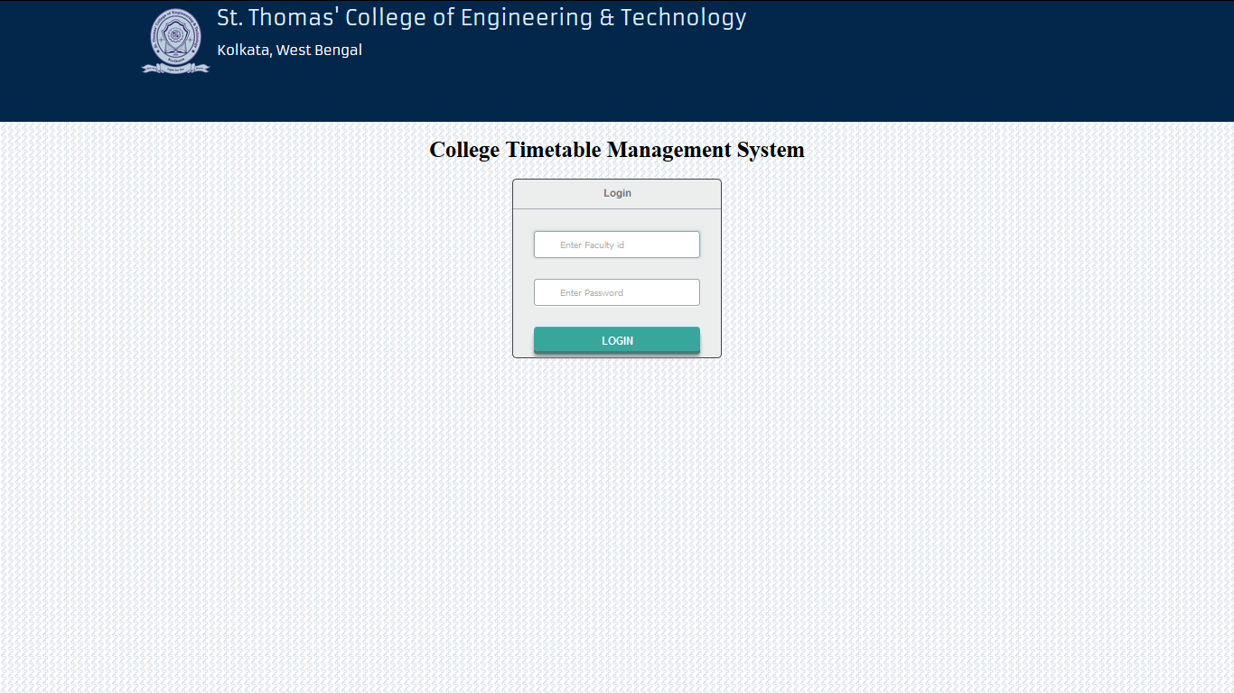
Login page:

Slide 38
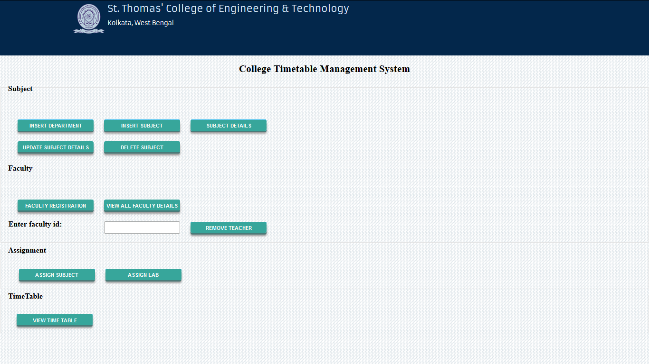
Admin home page:

Slide 39
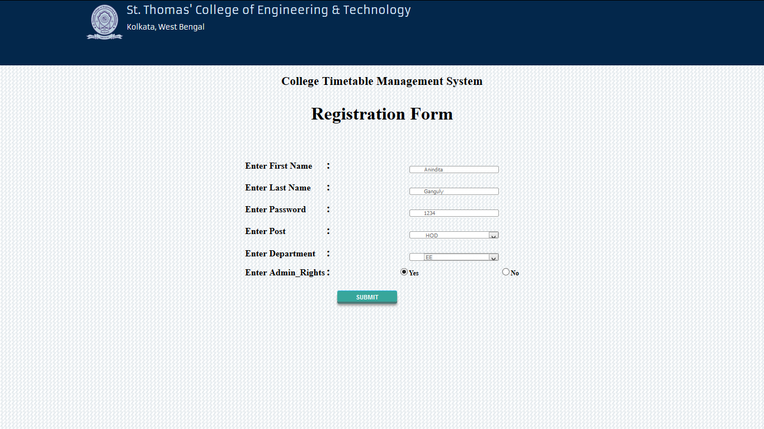
Faculty registration form:

Slide 40
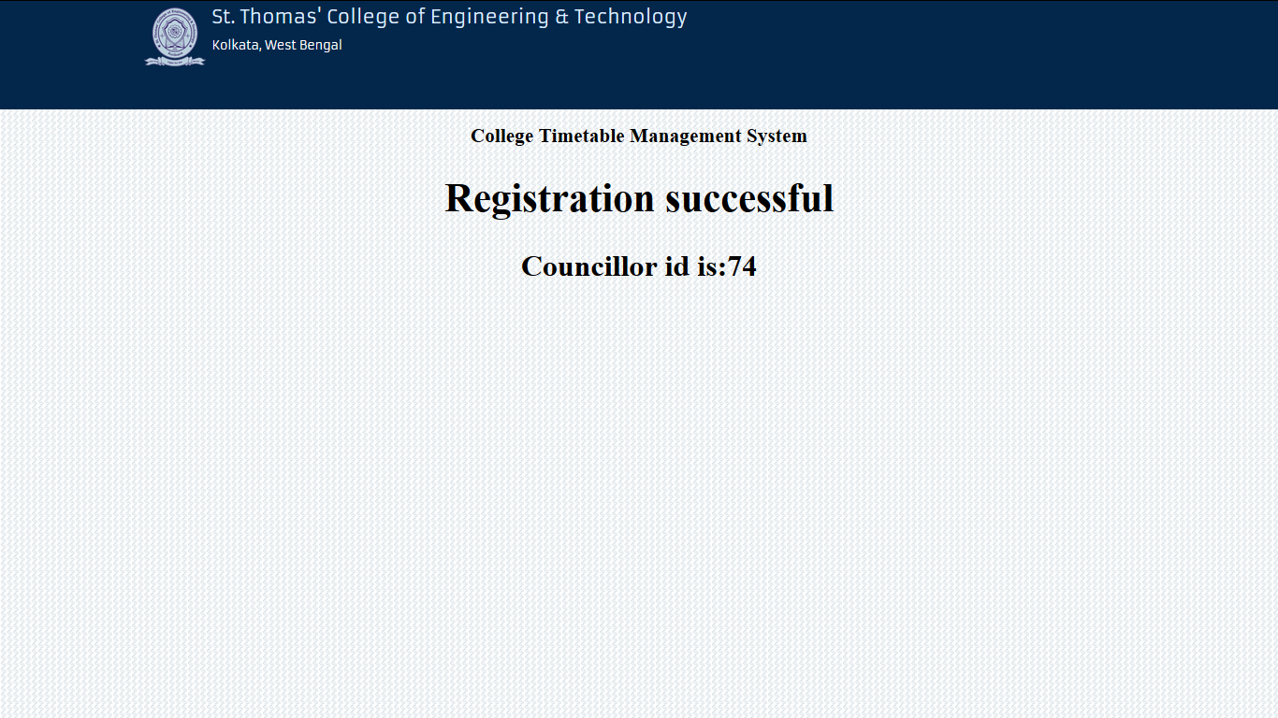
Registration Successful:

Slide 41
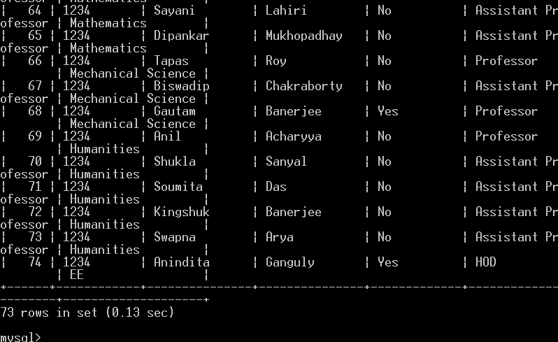
Database entry:

Slide 42
Faculty details delete form:

Slide 43
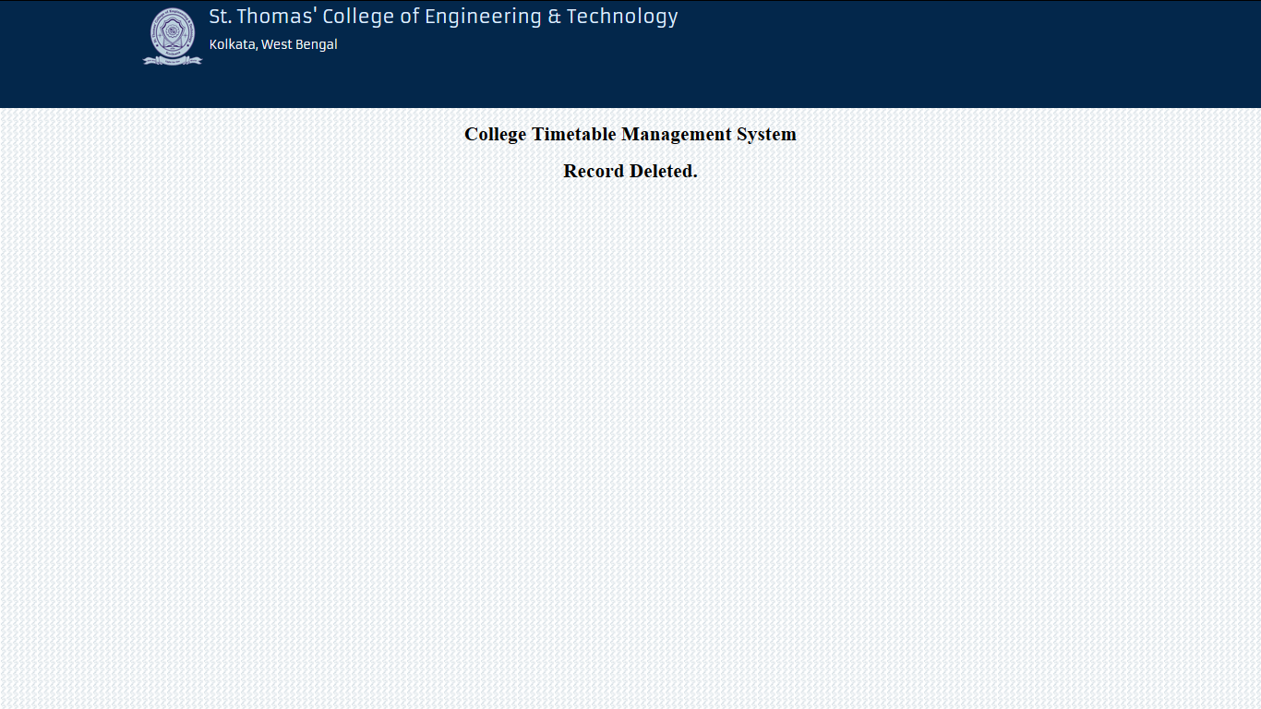
Successfully deleted:

Slide 44
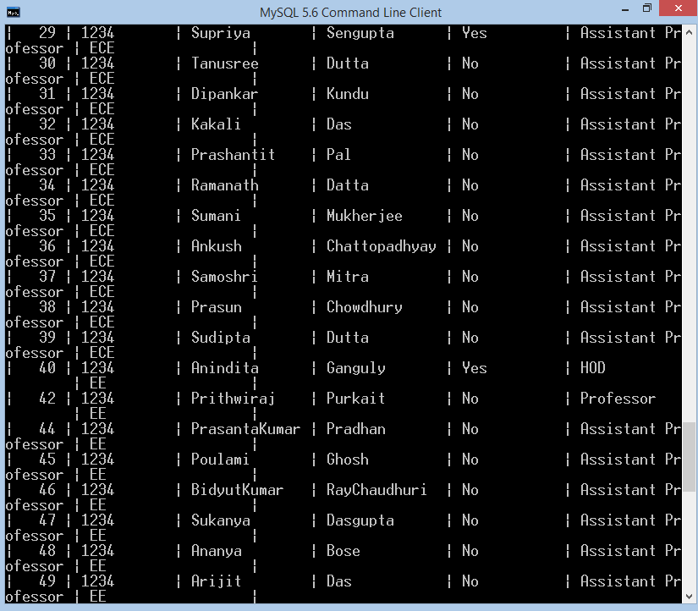
Database:

Slide 45
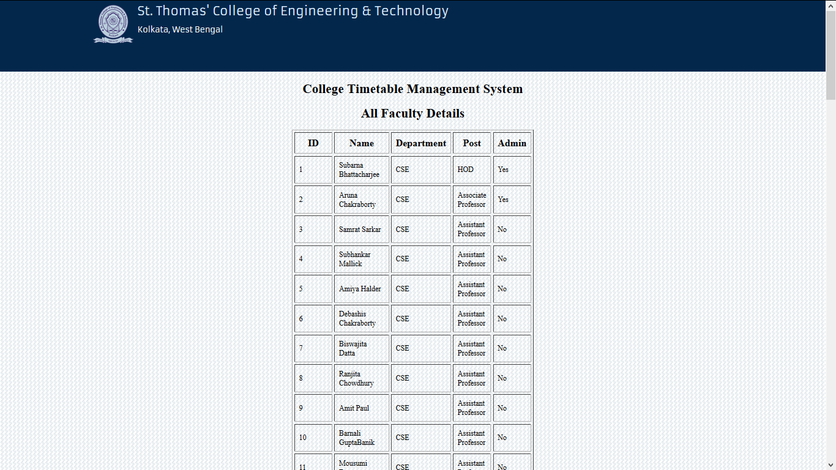
View all faculty details form:

Slide 46
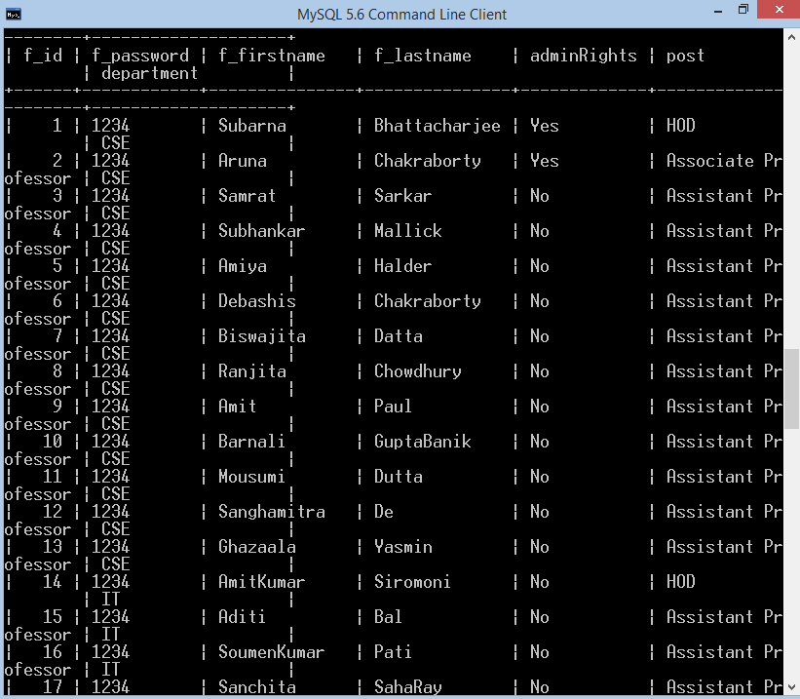
Details of all faculty:

Slide 47
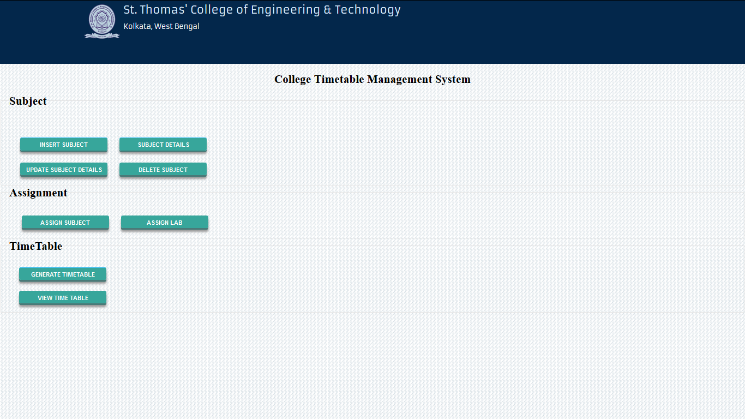
HOD home page:

Slide 48
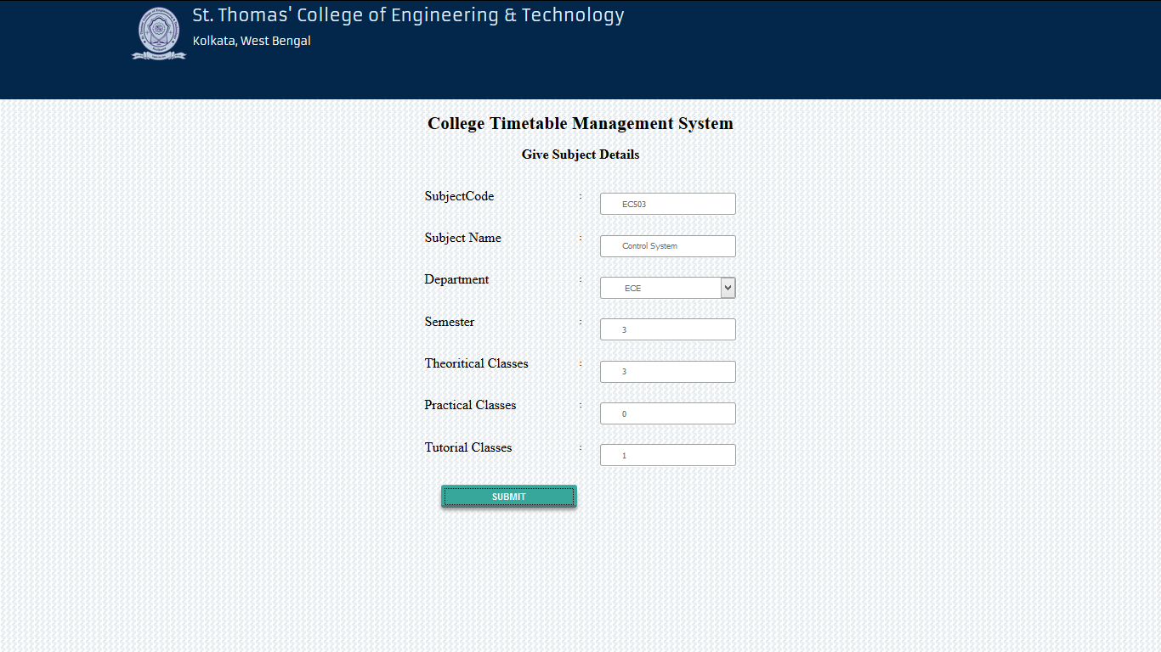
Subject insertion form:

Slide 49
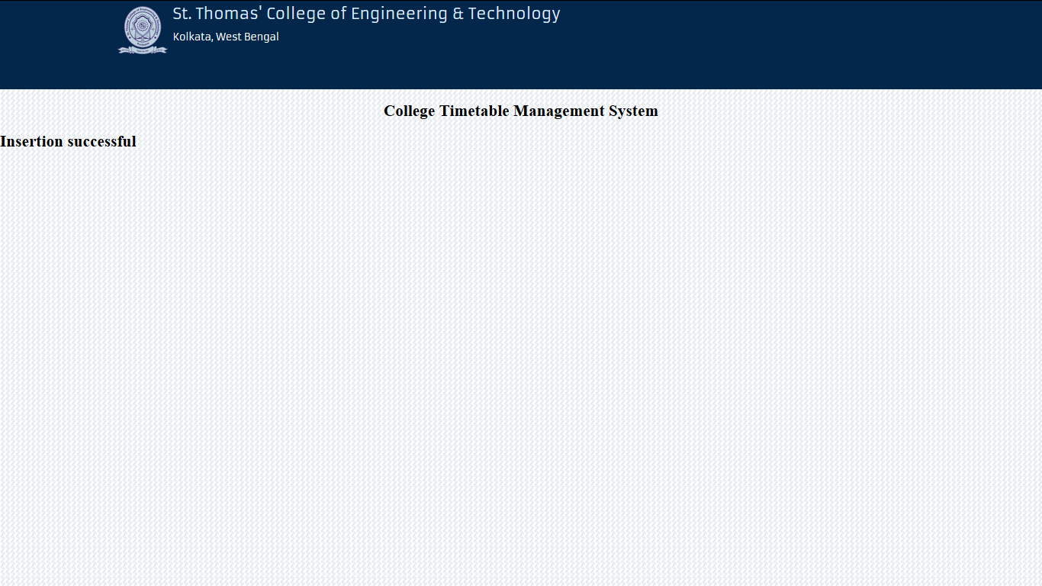
Successfully inserted:

Slide 50
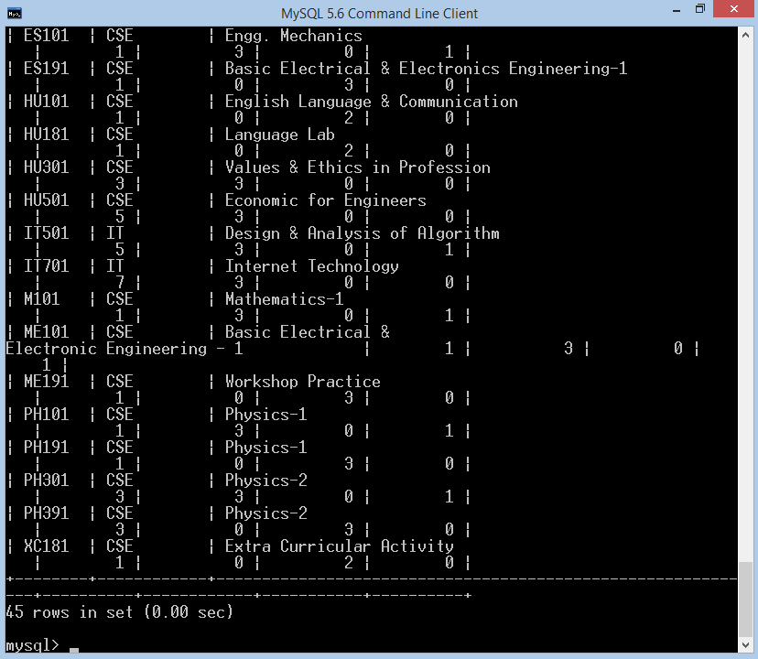
Database record:

Slide 51
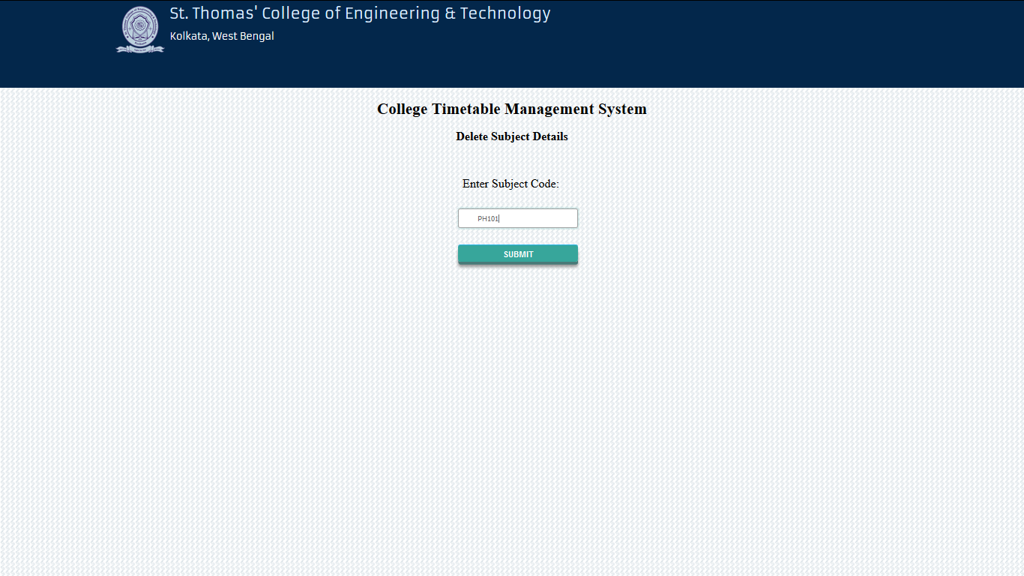
Subject delete form:

Slide 52
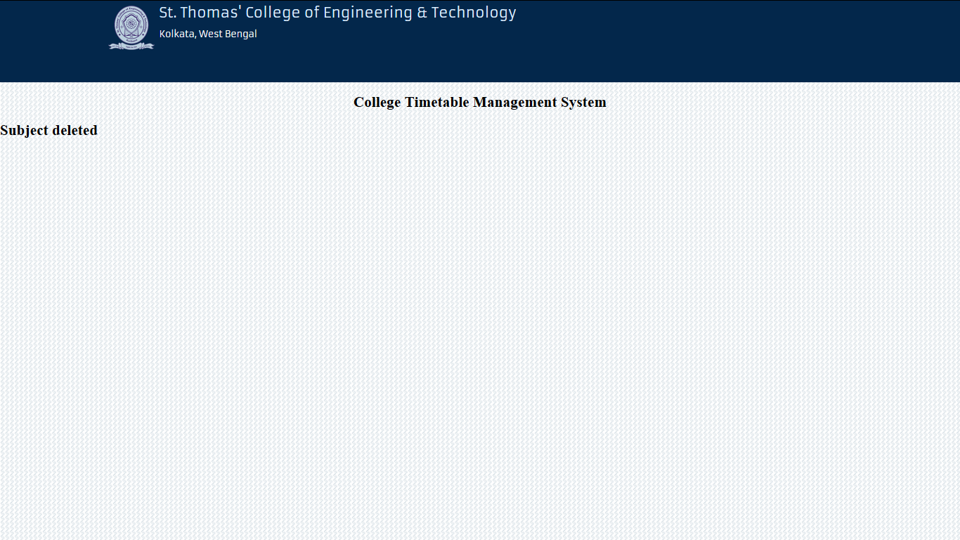
Subject Deleted:

Slide 53
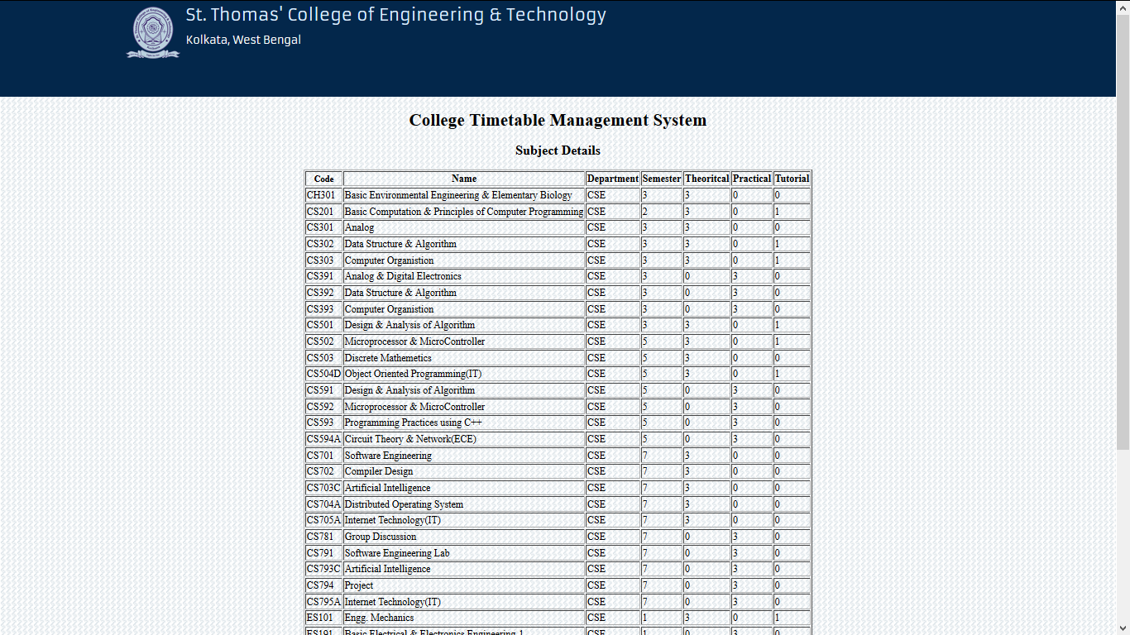
Subject details:

Slide 54

Subject details update form:

Slide 55
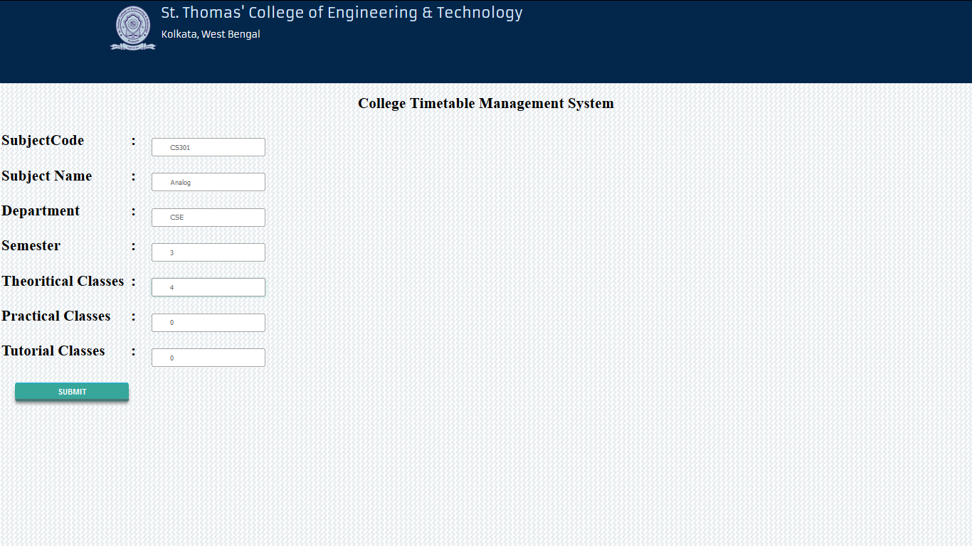
Subject details update form:

Slide 56
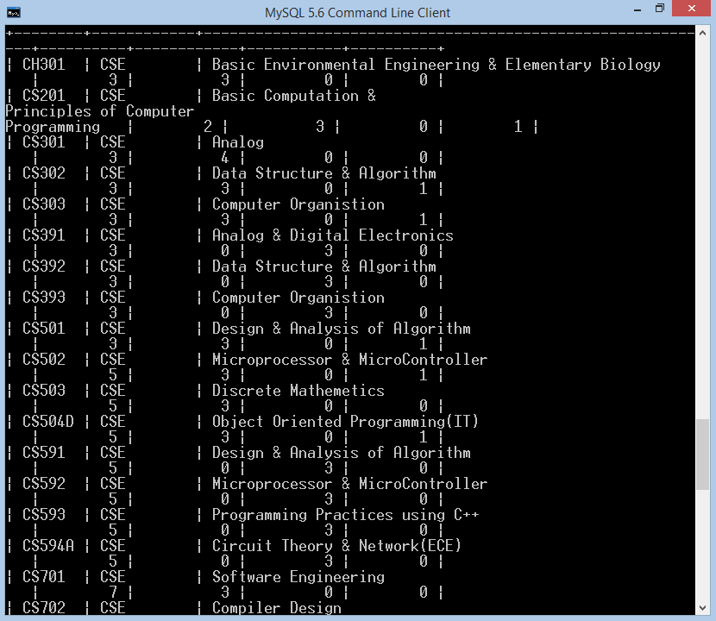
Updated record in database:

Slide 57
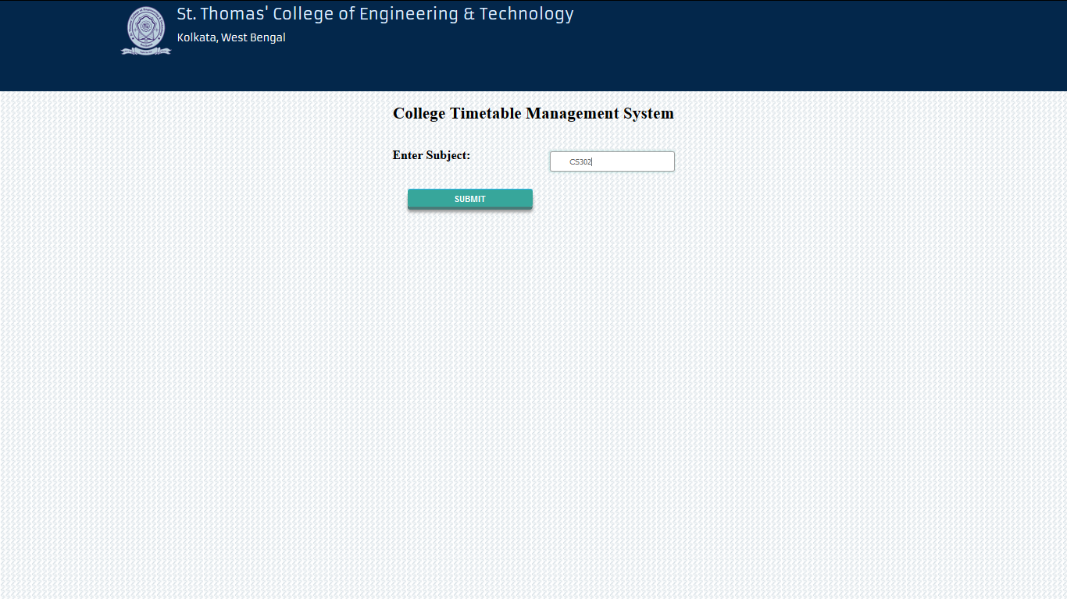
Assign faculty to subject form:

Slide 58
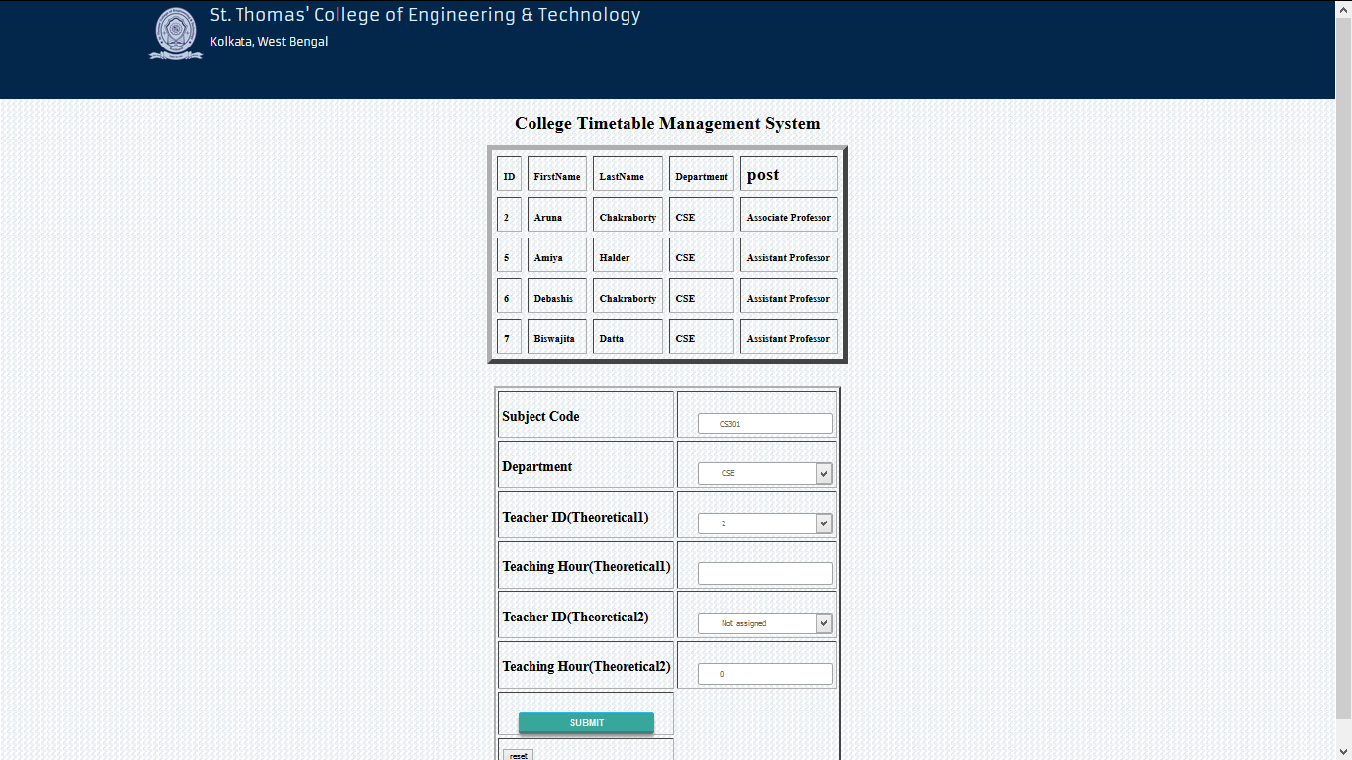
Assign faculty to lab:

Slide 59
Total teaching hour must be checked.
System fetch total teaching hour from subject database and check

Slide 60
Teaching hour table:
Teacher should have available time to teach the subject.
The assigned time is deducted form total teaching hour of a faculty.

Slide 61
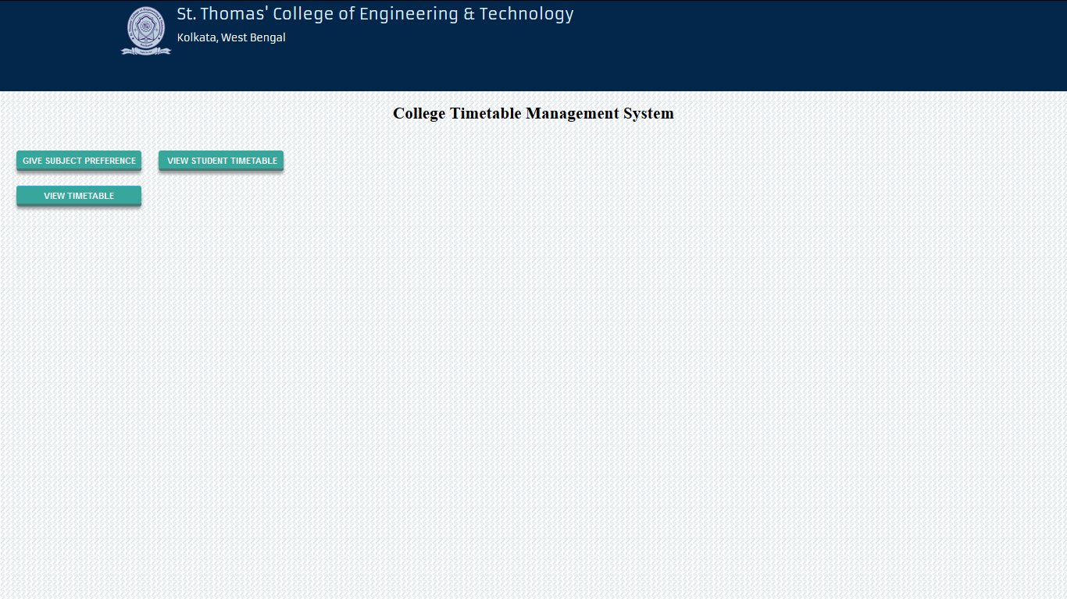
Faculty home page:

Slide 62
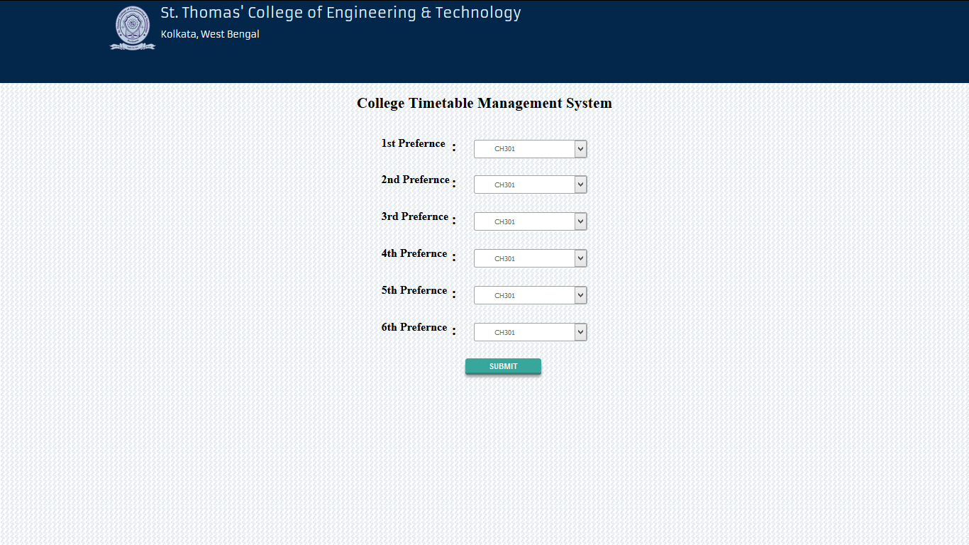
Enter preference details form:

Slide 63
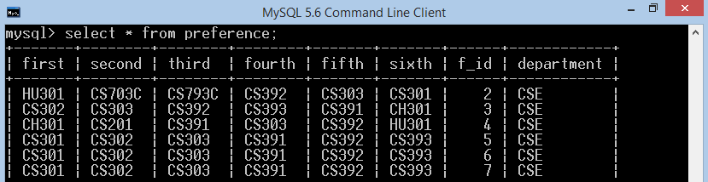
Preference database:

Slide 64
Generation :
Timetable will be generated department ,semester wise.
Timetable will be generated Teacher wise.
Timetable will be generated Lab wise.

Slide 65
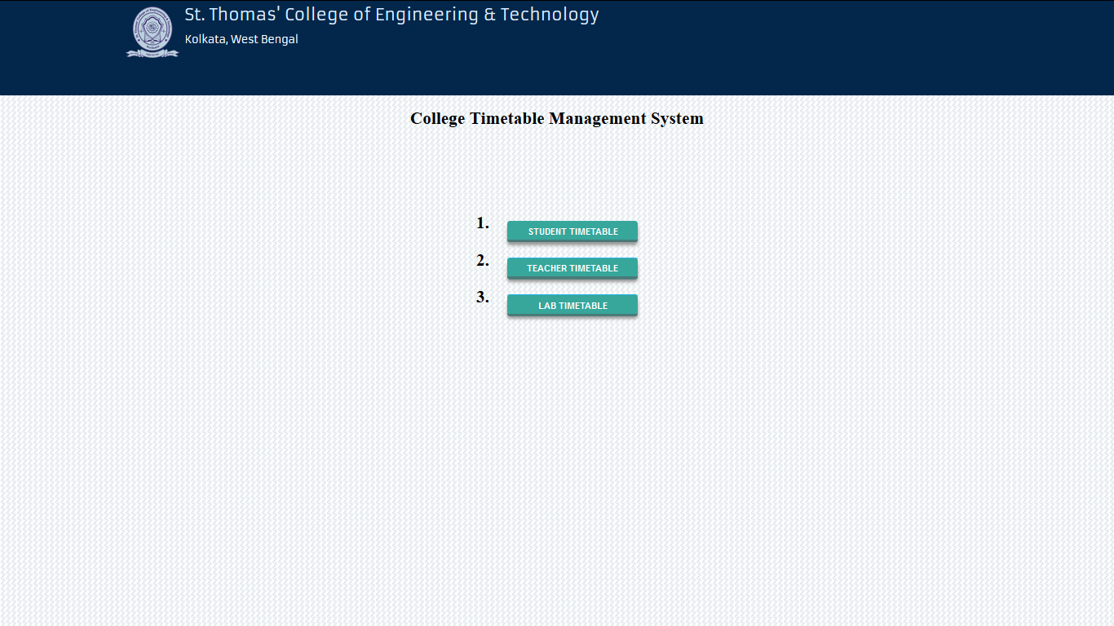
Timetable generation options:

Slide 66
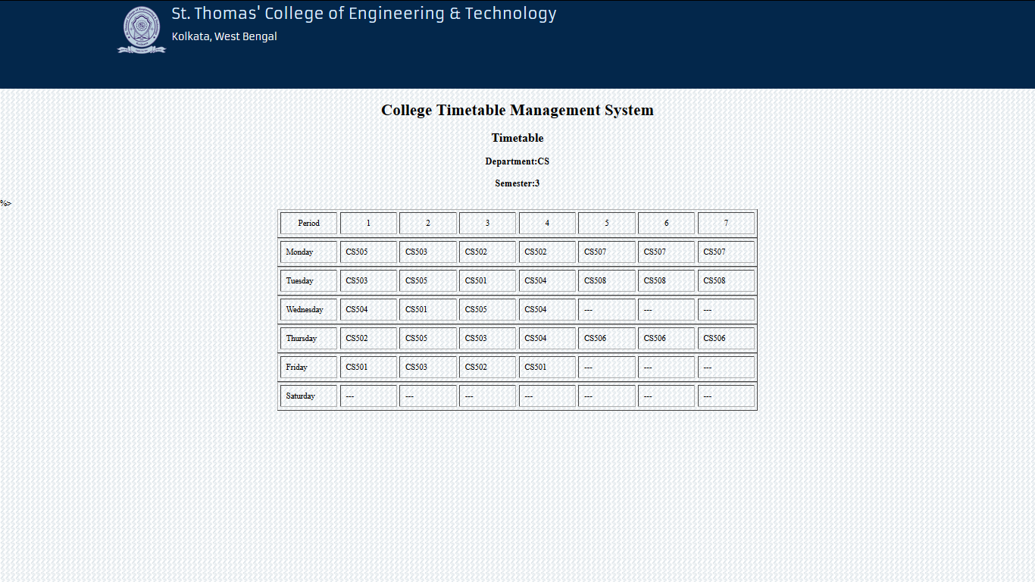
Student timetable:

Slide 67

Faculty timetable:

Slide 69
Algorithm for generation of timetable

Slide 70
Algorithm Design of the project
The algorithm looks from teacher’s point of view and tries to generate the timetable.
Before Generation the teacher must be assigned a subject and a lab must be assigned for a subject.

Slide 71
Lab 1
Subject 1
Subject 2
Subject 3
…
Subject m1
Lab 2
Subject 1
Subject 2
Subject 3
…
Subject m2
Lab 3
Subject 1
Subject 2
Subject 3
…
Subject m3
Lab 4
Subject 1
Subject 2
Subject 3
…
Subject m4
.
…
.
…
.
…
Lab n
Subject 1
Subject 2
Subject 3
…
Subject m5
where N,m1,m2,m3,…,mn ≥ 1
Lab assignment structure

Slide 72
Lab 1
Subject 1
Subject 2
Subject 5
Lab 2
Subject 4
Subject 3
Subject 6
Lab 3
Subject 12
Subject 8
Subject 11
Lab 4
Subject 10
Subject 9
Subject 7
Lab assignment structure

Slide 73
Sort the subjects year wise in ascending order
Lab 1
Subject 1
Subject 5
Subject 2
Lab 2
Subject 6
Subject 3
Subject 4
Lab 3
Subject 11
Subject 8
Subject 12
Lab 4
Subject 9
Subject 10
Subject 7
Lab assignment structure

Slide 74
Remove the top element from the lab list for lab 1
Lab 1
Subject 5
Subject 2
Lab 2
Subject 6
Subject 3
Subject 4
Lab 3
Subject 11
Subject 8
Subject 12
Lab 4
Subject 9
Subject 10
Subject 7
Lab assignment structure

Slide 75
Remove the top element from the lab list for lab 2
Lab 1
Subject 5
Subject 2
Lab 2
Subject 3
Subject 4
Lab 3
Subject 11
Subject 8
Subject 12
Lab 4
Subject 9
Subject 10
Subject 7
Lab assignment structure

Slide 76
Remove the top element from the lab list for lab 3
Lab 1
Subject 5
Subject 2
Lab 2
Subject 3
Subject 4
Lab 3
Subject 8
Subject 12
Lab 4
Subject 9
Subject 10
Subject 7
Lab assignment structure

Slide 77
Remove the top element from the lab list for lab 4
Lab 1
Subject 5
Subject 2
Lab 2
Subject 3
Subject 4
Lab 3
Subject 8
Subject 12
Lab 4
Subject 10
Subject 7
Lab assignment structure

Slide 78
Repeat until all the lab list is empty
Lab 1
Subject 5
Subject 2
Lab 2
Subject 3
Subject 4
Lab 3
Subject 8
Subject 12
Lab 4
Subject 10
Subject 7
Lab assignment structure

Slide 79
The lab assignment ends once all lab subjects are assigned
Lab 1
Lab 2
Lab 3
Lab 4
Lab assignment structure

Slide 80
Teacher 1
Subject 1
Subject 2
Subject 3
…
Subject m1
Teacher 2
Subject 1
Subject 2
Subject 3
…
Subject m2
Teacher 3
Subject 1
Subject 2
Subject 3
…
Subject m3
Teacher 4
Subject 1
Subject 2
Subject 3
…
Subject m4
.
…
.
…
.
…
Teacher n
Subject 1
Subject 2
Subject 3
…
Subject m5
Where N,m1,m2,m3,…mn ≥ 1
Teacher assignment structure

Slide 81
Soft constraints to be followed while assigning classes to teacher
A subject should not have more than one class on a particular day.
Two consecutive class should not be taken by same teacher.
One subject should not assigned more than once in one day.
There should not be off period in between.
One teacher should have a non-teaching day in a week.
Theoretical Classes should not be in second half.

Slide 82
Teacher 1
Subject 1
Subject 2
Subject 5
Teacher 2
Subject 4
Subject 3
Subject 6
Teacher 3
Subject 12
Subject 8
Subject 11
Teacher 4
Subject 10
Subject 9
Subject 7
Teacher assignment structure

Slide 83
All soft constraint satisfied then assign the top subject from the teacher assigned list for teacher 1
Teacher 1
Subject 2
Subject 5
Teacher 2
Subject 4
Subject 3
Subject 6
Teacher 3
Subject 12
Subject 8
Subject 11
Teacher 4
Subject 10
Subject 9
Subject 7
Teacher assignment structure

Slide 84
All soft constraint satisfied then assign the top subject from the teacher assigned list for teacher 2
Teacher 1
Subject 2
Subject 5
Teacher 2
Subject 3
Subject 6
Teacher 3
Subject 12
Subject 8
Subject 11
Teacher 4
Subject 10
Subject 9
Subject 7
Teacher assignment structure

Slide 85
All soft constraint were not satisfied then assign the top subject from the teacher assigned list for teacher 3
Teacher 1
Subject 2
Subject 5
Teacher 2
Subject 3
Subject 6
Teacher 3
Subject 8
Subject 11
Subject 12
Teacher 4
Subject 10
Subject 9
Subject 7
Teacher assignment structure

Slide 86
All soft constraint were satisfied then assign the top subject from the teacher assigned list for teacher 4
Teacher 1
Subject 2
Subject 5
Teacher 2
Subject 3
Subject 6
Teacher 3
Subject 8
Subject 11
Subject 12
Teacher 4
Subject 9
Subject 7
Teacher assignment structure

Slide 87
Repeat until the list is empty or no further subjects can be assigned following soft constraint
Teacher 1
Teacher 2
Teacher 3
Subject 12
Teacher 4
Teacher assignment structure

